Slide 1
DATA ANALYSIS PROJECT TITLE: SUPERMARKET SALES ANALYSIS BY: ALFRED DANIEL CHIBUZO

Slide 2
ANALYSIS OVERVIEW
The analysis provides insights into supermarket sales report of a business over a one-year period(2024). The report covers three different branches of the business in terms of customer types, gender, product line, unit price, quantity, payment and ratings.

Slide 3
AIM AND OBJECTIVE
AIM
The main aim of this analysis is to understand the overall performance of the business, the contribution of the various branches as well as the gap with a view to offer recommendation on areas of potential improvement.
OBJECTIVE
To assess the total annual revenue generated
To determine the rating of business by customers
To analyze the performance of three branches and the gender spread
To assess the revenue generation of customer types and determine the contribution of various payment channels
To evaluate the monthly and quarterly sales performance
Compare the revenue generated by different product lines

Slide 4
DATA SOURCE
The dataset used for this analysis was sourced from Kaggle.com, a reservoir of a wide range of datasets for data analysis.

Slide 5
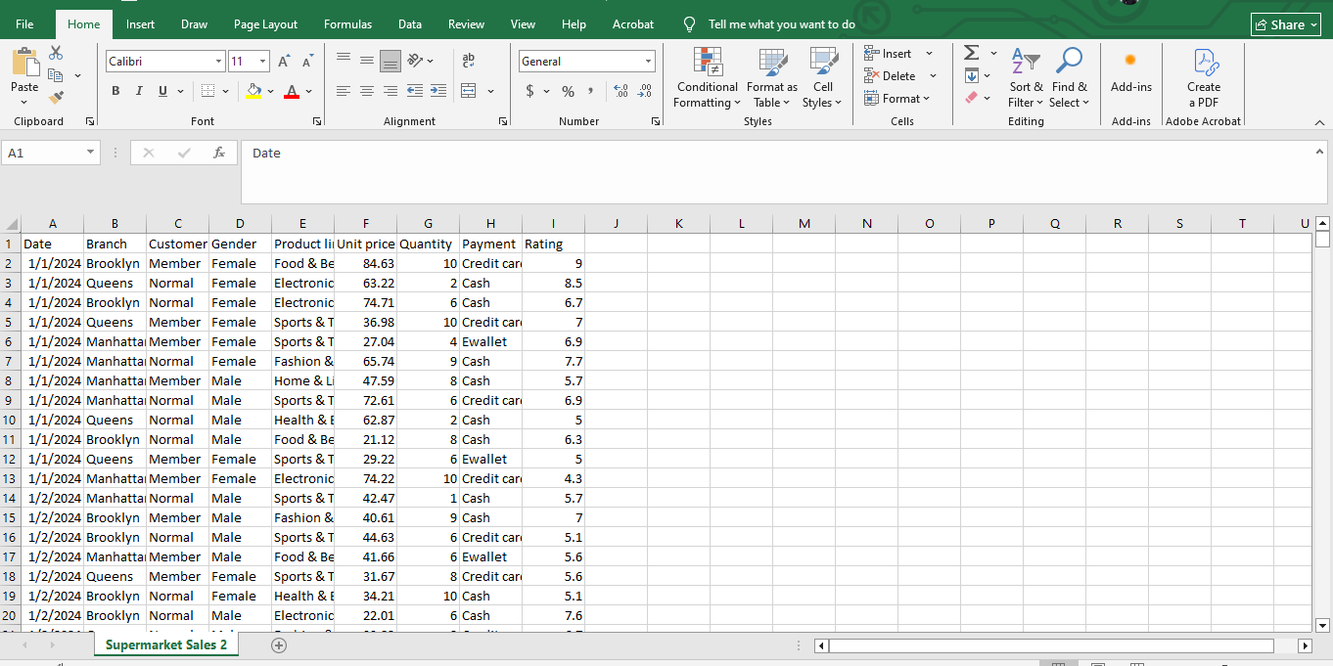
RAW DATA

Slide 6
DATA CLEANING AND TRANSFORMATION
Altering Table: To be able to analyze sales performance of the supermarket, an additional column named ‘sales’ was added
Blank Removal: To minimize errors, I checked for and removed all blanks that are not relevant to focus of our analysis
Removing Duplicates: I checked for and remove any duplicate rows to ensure data integrity.
Correcting Inaccuracies: I verified the accuracy of the data and correct any inconsistencies or errors.
Data integrity: To ensure integrity of the data, I carried out similarly cleaning and data manipulations using excel function and Postgrel SQL to double check for any inconsistence and error

Slide 7
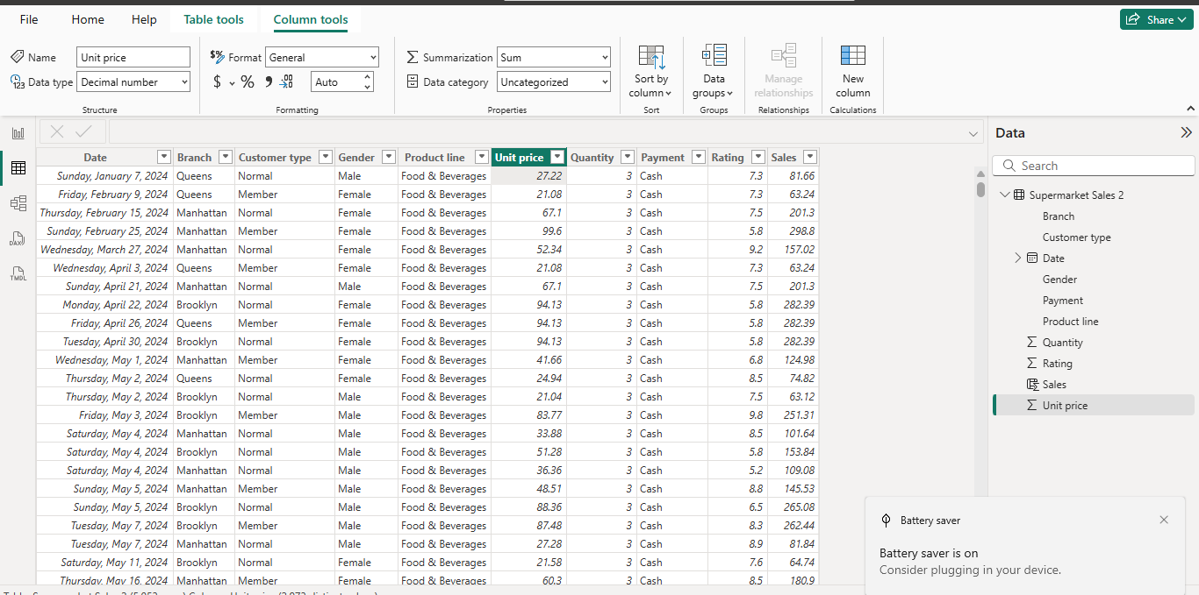
CLEANED AND TRANSFORMED DATA

Slide 8
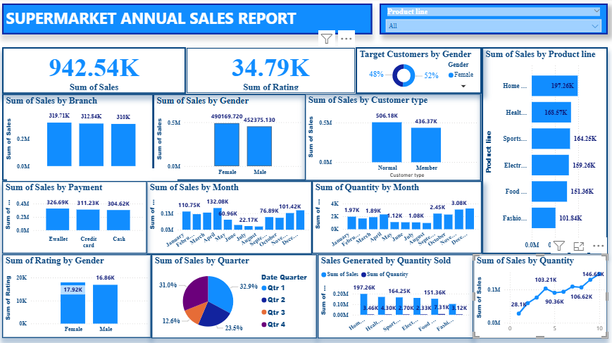
EXECUTIVE SUMMARY DASHBOARD

Slide 9
Executive Summary
Key Highlights:
Total sales generated as analyzed between January to December 2024 was $942,540 with highest sales seen in April($132,083) and lowest in August($19,440) while the overall rating was 34,790 .
Brooklyn branch outperform other branches by delivering sales of $319,705 compared with Queens and Manhattan branches at $312,842 and 309,996 respectively
As analyzed the supermarket was patronized by slightly more females(52%) than males(48%)
Majority of sales was contributed by the Normal customer types($506,176) compared with Member customer types($436,368)
The predominant method of payment was Ewallet($326,691) followed by Credit card($311,230) and Cash($304,622) in that order
Home & Lifestyle product line recorded the highest sales($197,260) while Fashion & Accessories had the lowest($101,844)

Slide 10
DEEP DIVE INTO INSIGHTS

Slide 11
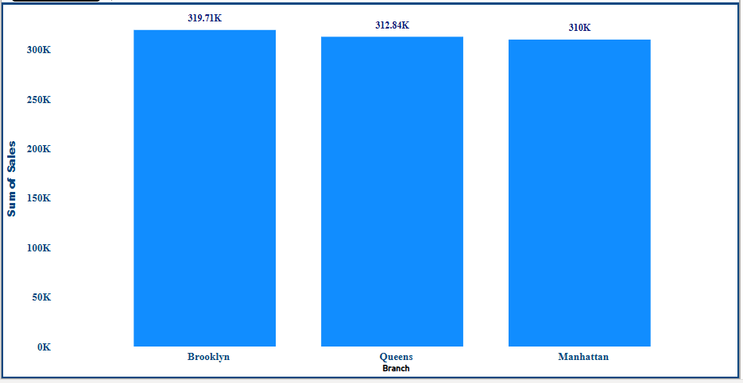
PERFORMANCE BY BRANCH

Slide 12
PERFORMANCE BY BRANCH CONTINUE
The performance of the three Supermarket branches Brooklyn, Queens and Manhattan were $319,705, $312,842 and $309,996 respectively
As observed Brooklyn branch delivered superior performance compared with Queens and Manhattan branches
Recommendation
Carry out further analysis of drivers of performance at Brooklyn and identify opportunity for growth at the other branches
Identify barriers for growth at the other branches and develop strategy to overcome them.
Increase focus on Queens and Manhattan branches and where necessary deploy resources accordingly

Slide 13
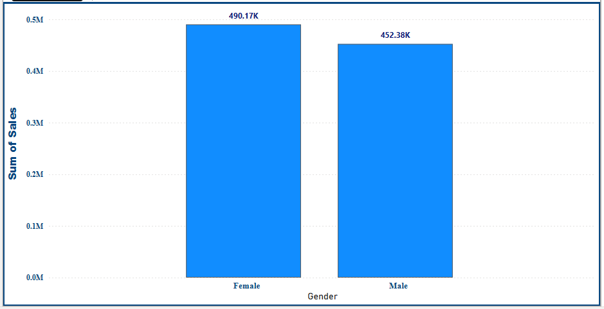
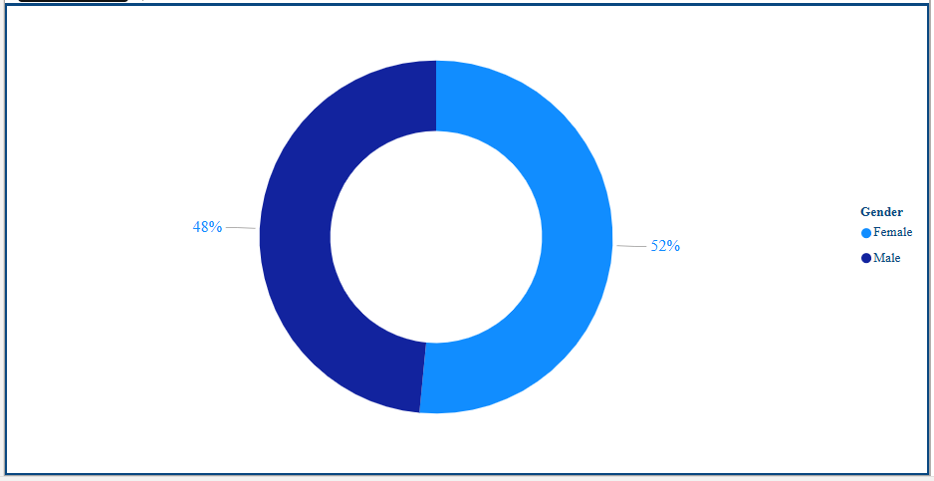
GENDER PERFORMANCE

Slide 14
GENDER PERFORMANCE CONTD
Overall sales recorded by Female and Male was $490,169(52%) and $452,375(48%) respectively
This shows that more female patronize the Supermarket than males
Recommendation
Ensure constant availability of Home & Lifestyle, and Health & Beauty product lines to drive sales
Create incentive through Membership to encourage more purchase of products

Slide 15
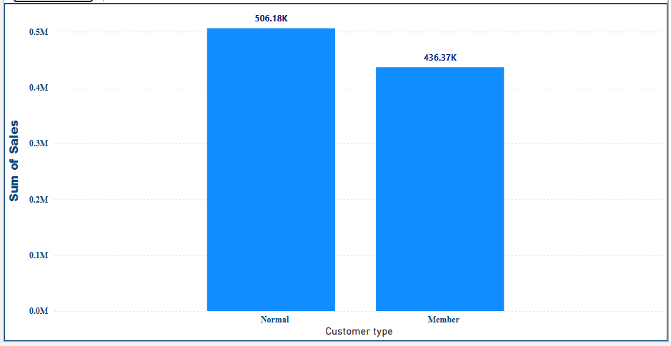
CUSTOMER SALES PERFORMANCE

Slide 16
CUSTOMER SALES PERFORMANCE CONTD
As analyzed the report showed sales performance of $506,176 and $436,368 for Normal and Member customer types.
This indicates that most of the sales were contributed by the Normal customers.
Recommendation
Drive targeted campaign to attract and recruit more customers in the membership category

Slide 17
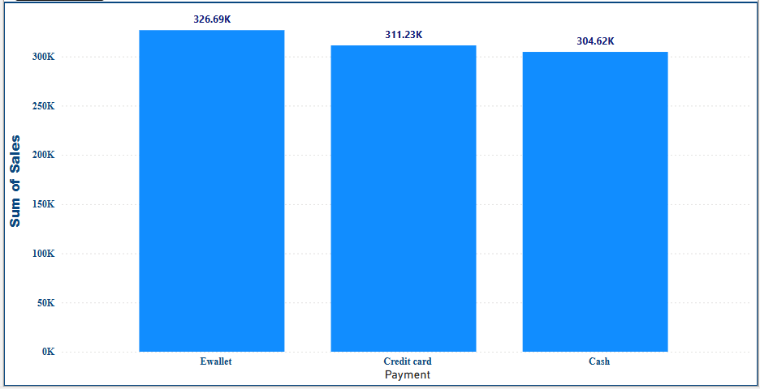
SALES BY PAYMENT METHOD

Slide 18
SALES BY PAYMENT METHOD CONTD
Three payment methods were deployed across the branches namely: Ewallet, Credit card and Cash
From the analyzed report, Ewallet recorded the highest transaction while Cash had the least transactions.
Recommendation
Maintain Status quo

Slide 19
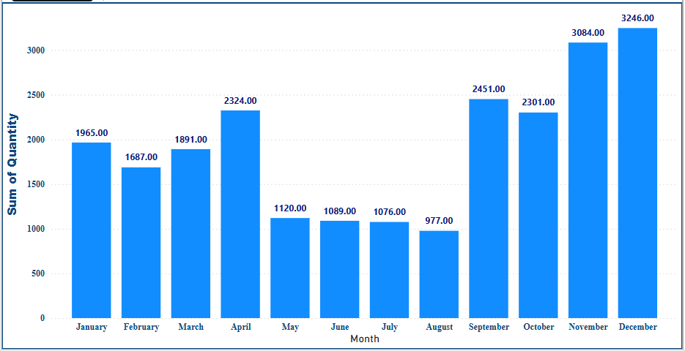
MONTHLY SALES PERFORMANCE BY QUANTITY

Slide 20
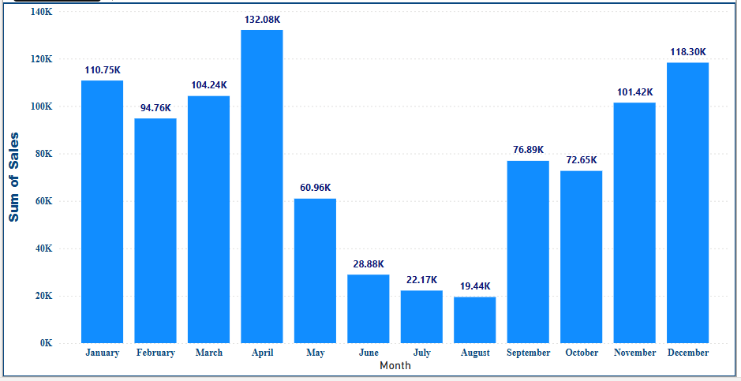
MONTHLY SALES PERFORMANCE BY REVENUE

Slide 21
MONTHLY SALES PERFORMANCE QUNATITY AND REVENUE
The report analyzed showed the highest quantity of all products sold was in December while the least sold was in August
In a similar vein, the highest revenue generated of all products sold was in April while the least generated revenue was in August
Although December had the highest quantity of products sold, the revenue generated was lower compared with the month of April with highest revenue generated. Major drivers to these are Health & Beauty, Food & Beverage, and Fashion & Accessories Products
Recommendation
Protect and defend the major revenue drivers like Home & Lifestyle, Health & Beauty, and Sports & Travel product lines.
Targeted product campaign around Electronics, Food & Beverage, and Fashion & Accessories Products

Slide 22
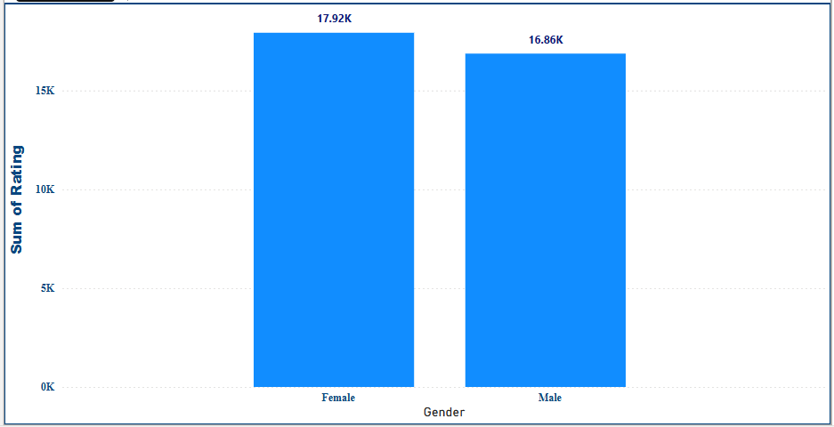
CUSTOMER RATING BY GENDER

Slide 23
CUSTOMER RATING BY GENDER
The total rating analyzed for male was 16,864 while that of female was 17,920 showing that more females provided feedbacks compared to males.
Recommendation
Encourage more males to share feedbacks

Slide 24
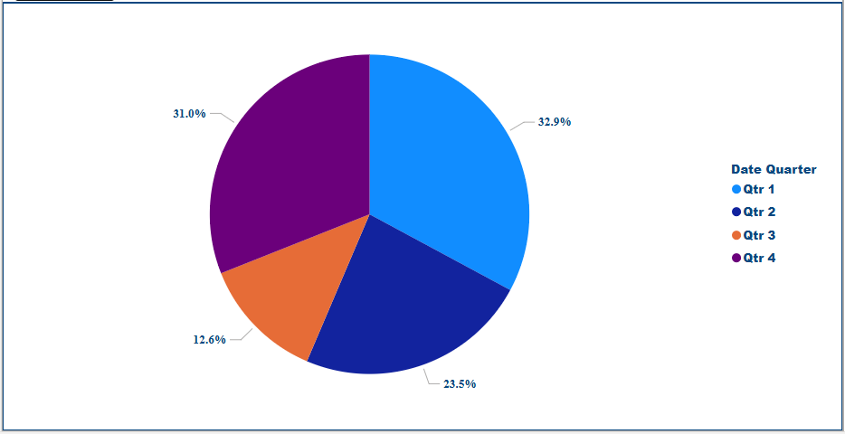
QUARTERLY SALES PERFORMANCE

Slide 25
QUARTERLY SALES PERFORMANCE
Quarter 1(Q1) recorded the highest sales followed by Q4, Q2 and Q3 respectively.
Recommendation
Create a product campaign at the beginning of Q3 to drive brand awareness and improve sales

Slide 26
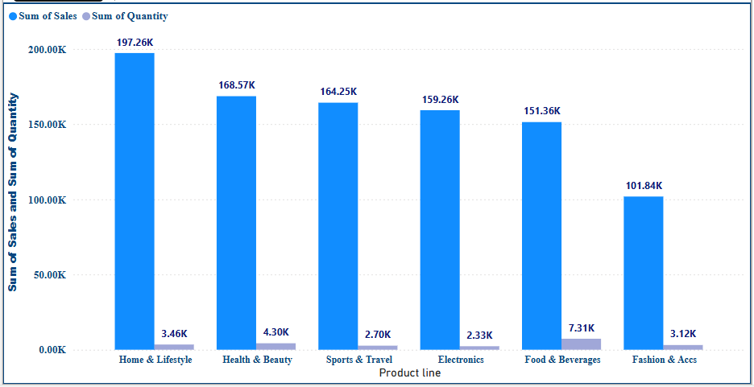
PRODUCT SALES PERFORMANCE

Slide 27
PRODUCT SALES PERFORMANCE
Home & Lifestyle product demonstrated a strong sales performance with highest revenue of $197,260. On the other hand, Fashion and accessories had the lowest revenue of $101,844
Recommendation
Drive engagement and campaign on Fashion and Accessories while maintaining focus on the other products
Consider discount offer on Fashion and Accessories to stimulate customers interest e.g buy 5 items get 1 free. Targeting female clients.

Slide 28
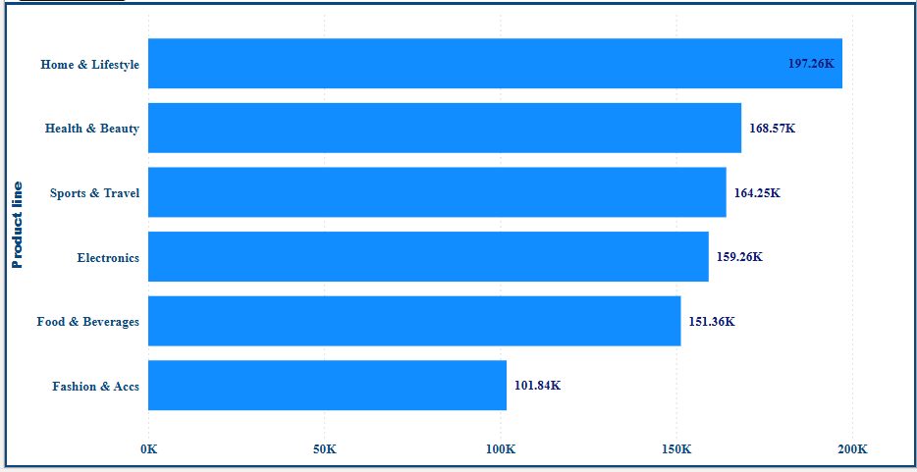
PRODUCT PERFORMANCE

Slide 29
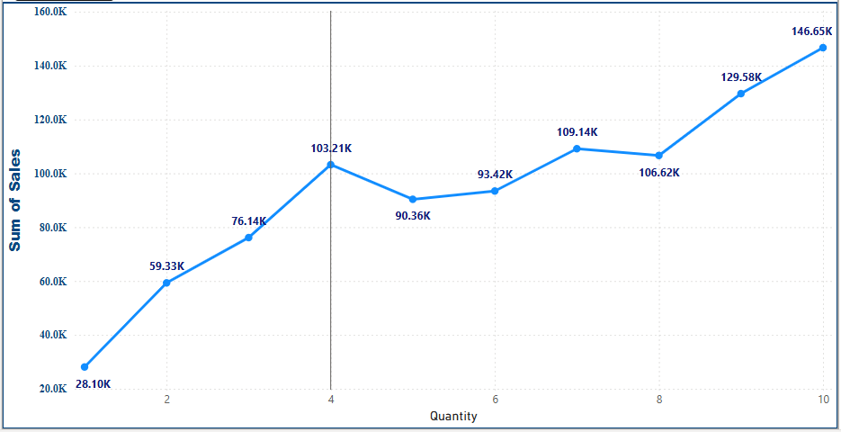
REVENUE AND QUANTITY SOLD COMPARISON

Slide 30
CONCLUSION AND RECOMMENDATION
The Supermarket sales data analyzed shows insightful information on areas of strength as well as areas of improvement.
Highest sales was seen in April($132,083) and lowest in August($19,440) while the overall rating was 34,790 .
Recommendation
Protect and defend the major revenue drivers like Home & Lifestyle, Health & Beauty, and Sports & Travel product lines.
Ensure constant availability of Home & Lifestyle, and Health & Beauty product lines to drive sales
Targeted product campaign around Electronics, Food & Beverage, and Fashion & Accessories Products
Drive engagement and campaign on Fashion and Accessories while maintaining focus on the other products
Consider discount offer on Fashion and Accessories to stimulate customers interest e.g buy 5 items get 1 free. Targeting female clients.

Slide 31
THANK YOU

